Slide 1
Premier League Goals & Weather Analysis
EDA & Hypothesis Testing
Mazen Zeybek
00033539

Slide 2
My Data sets
Premier League datasets including all matches for (2000/2001, 2001/2002, 2020/2021, and 2021/2022) downloaded from kaggle
Weather datasets for the same time periods purchased on Visual Crossing

Slide 3
Outline
Data Overview
Seasonal Goals Comparison
Weather Impact
Temperature Effects
Attendance Impact
VAR Era Comparison
Time-of-Day Analysis
Hypothesis Testing
Conclusions

Slide 4
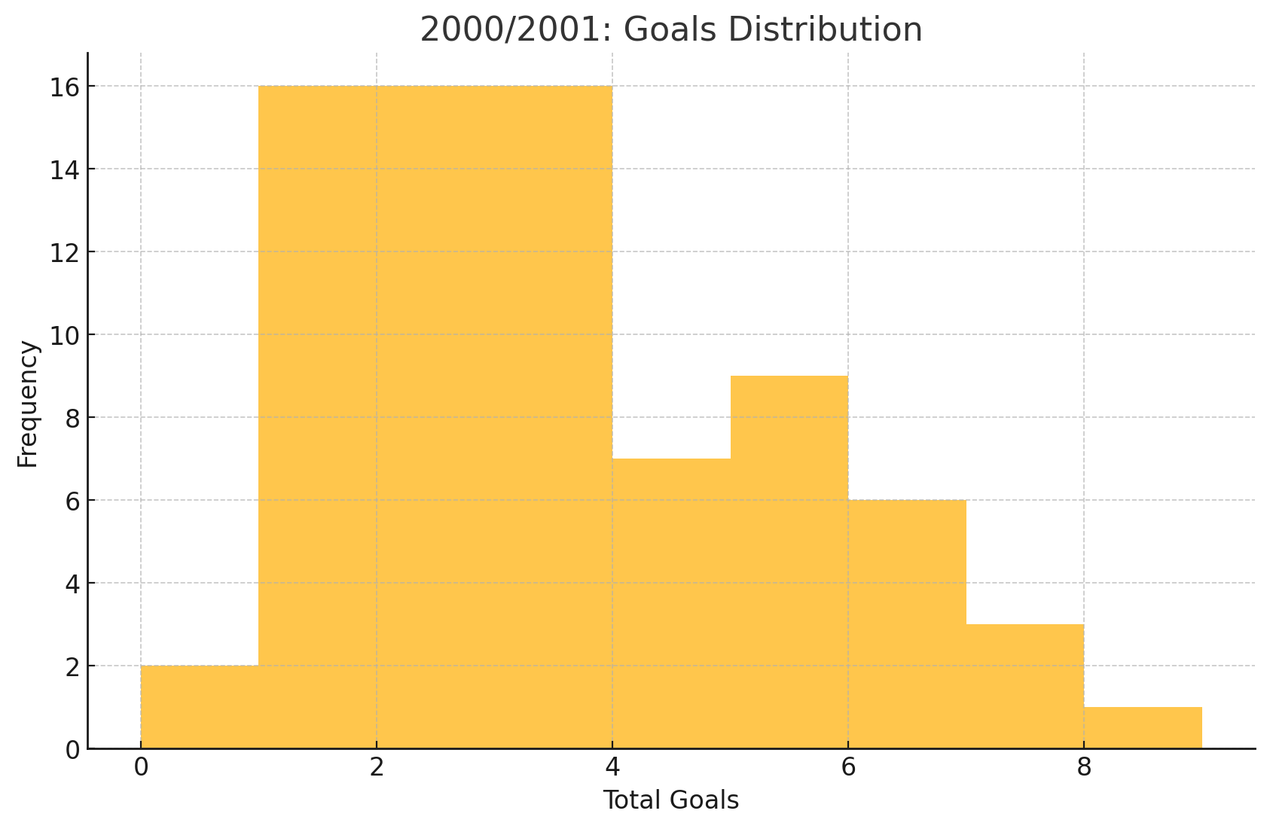
2000/2001: Goals Distribution
Average goals per match = 3.08

Slide 5
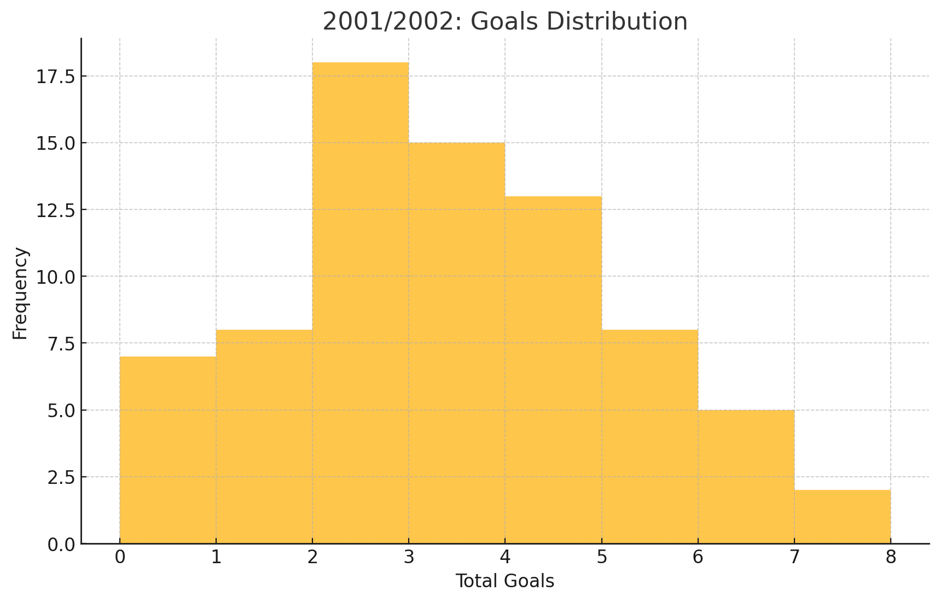
2001/2002: Goals Distribution
Average goals per match = 2.96

Slide 6
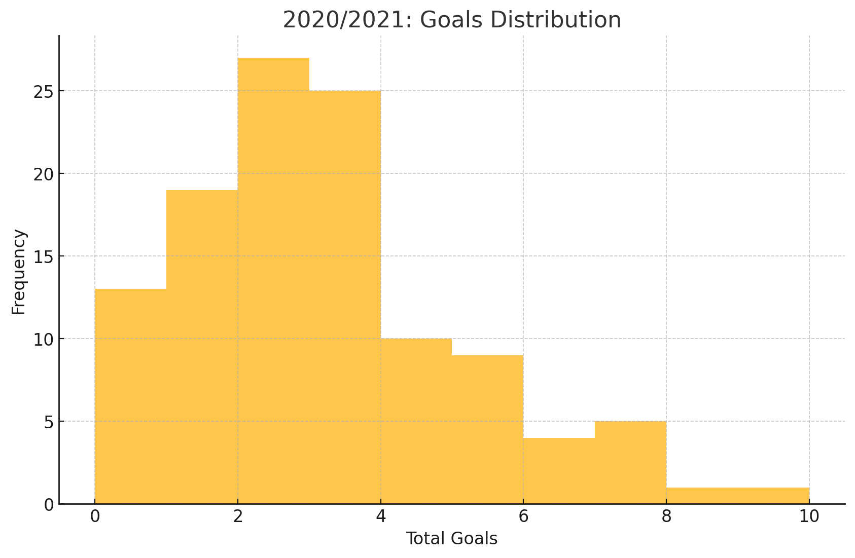
2020/2021: Goals Distribution
Average goals per match = 2.71

Slide 7
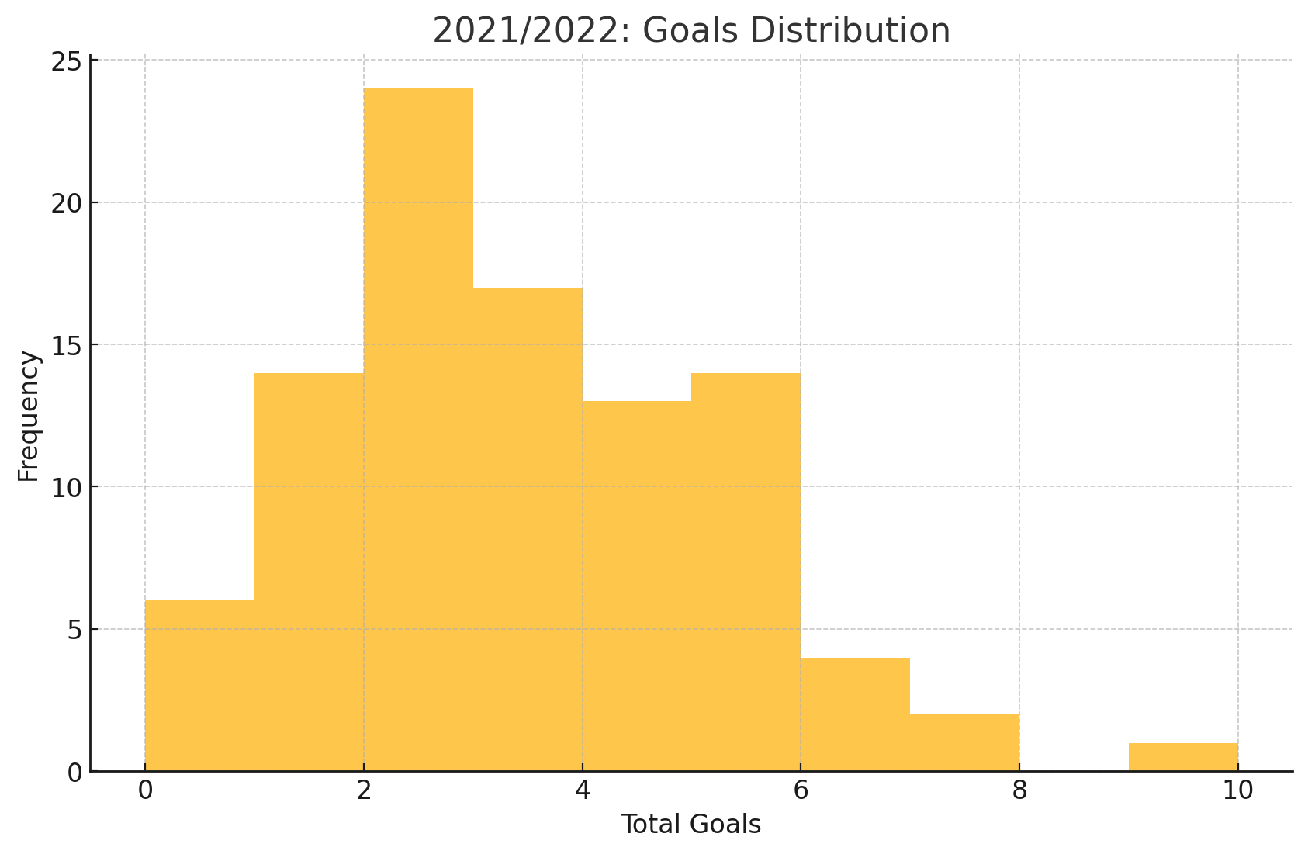
2021/2022: Goals Distribution
Average goals per match = 2.97

Slide 8
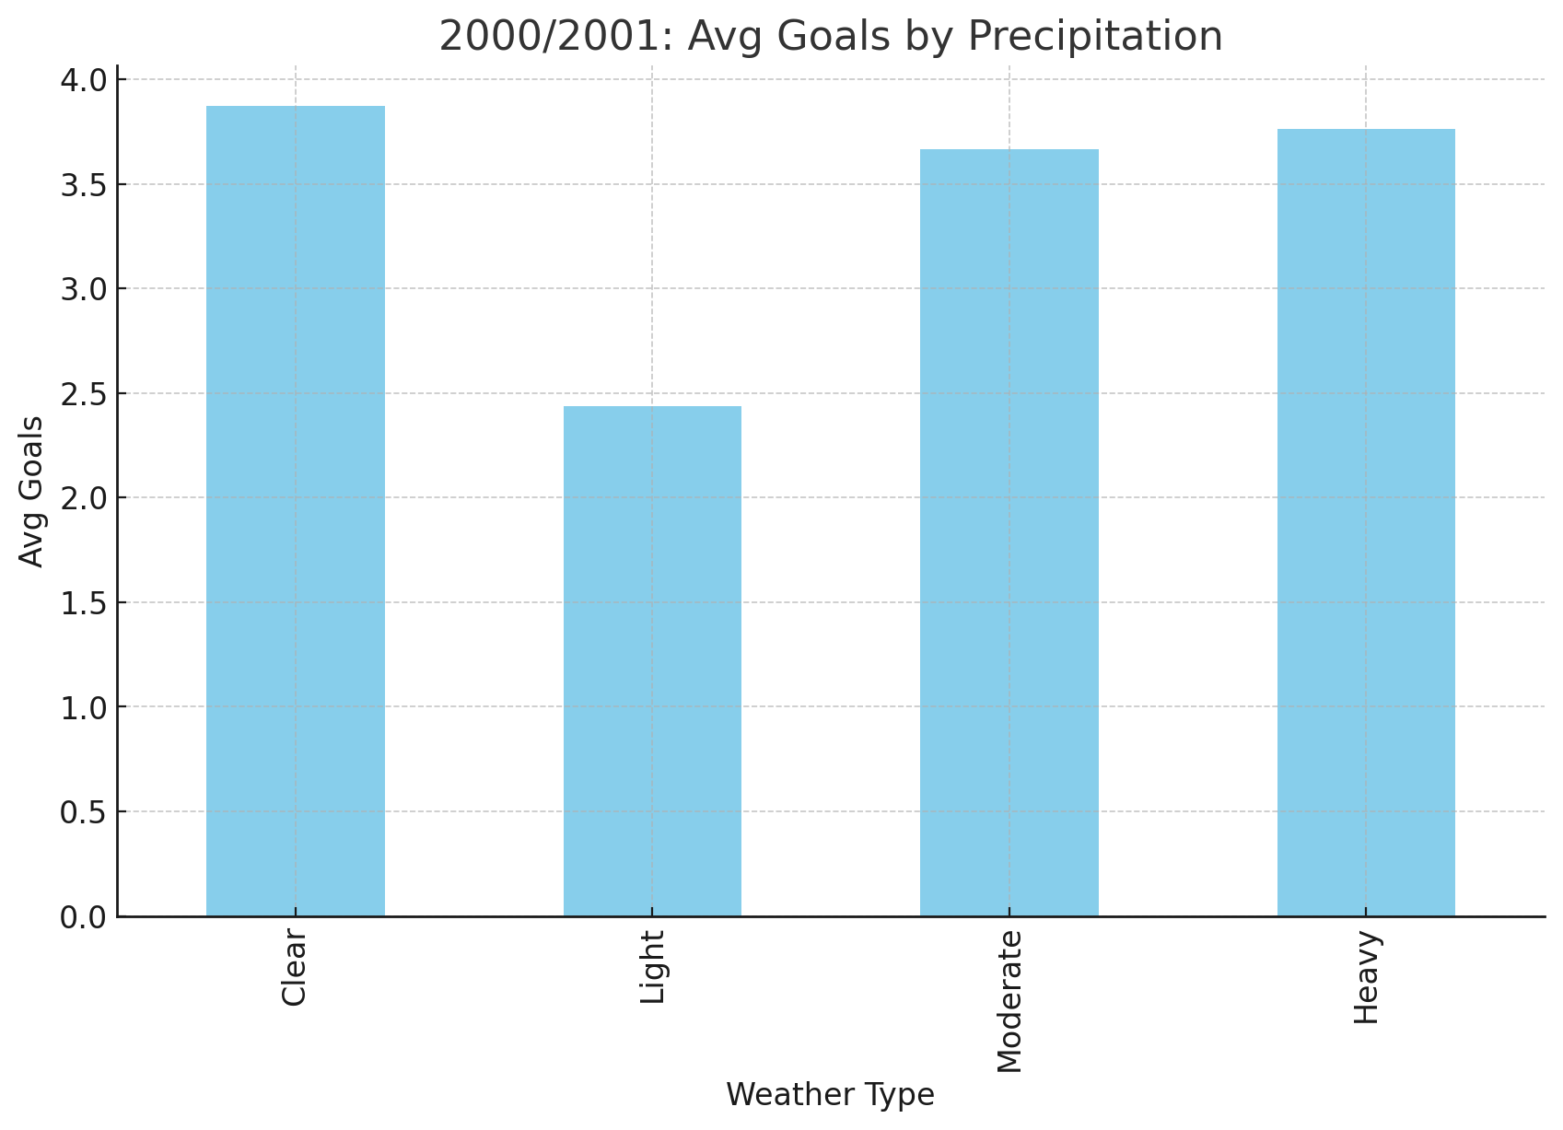
2000/2001: Weather Impact
In the 2000/2001 season there seems to be no significant correlation between weather and precipitation levels,
Clear weather has a similar avg of goals with , moderate and heavy precipitation.
While Light precipitation (light rain) seems to show a decrease in the avg number of goals scored

Slide 9
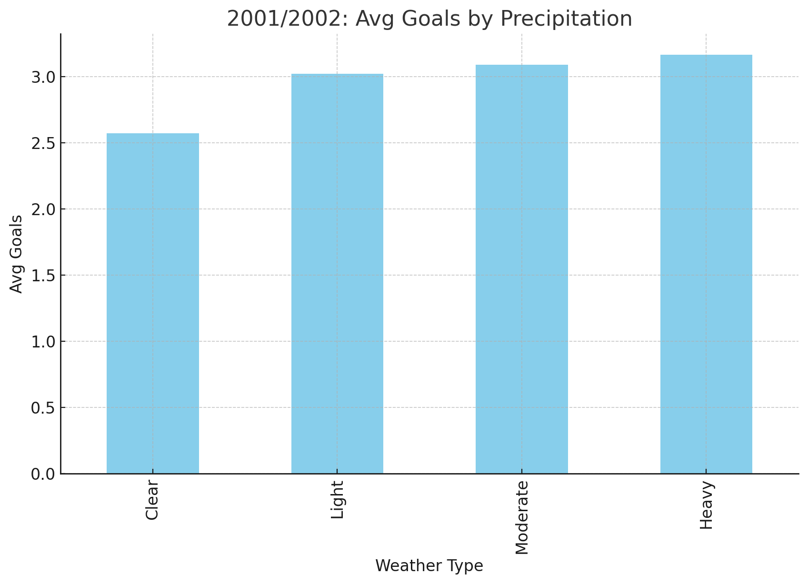
2001/2002: Weather Impact
In the 2001/2002 season there seems to be no significant correlation between weather and precipitation levels.
Light, moderate and heavy precipitation all to have a very close avg goals scored.
While clear weather seems to show a decrease in the avg number of goals scored

Slide 10
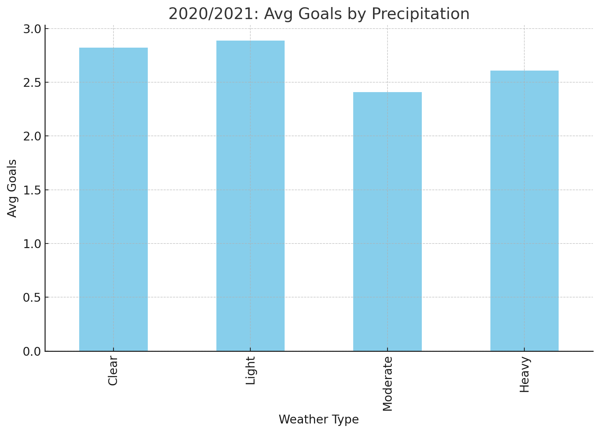
2020/2021: Weather Impact
In the 2020/2021 season there seems to be no significant correlation between weather and precipitation levels.
Clear weather and all precipitation levels have a similar number of avg goals scored

Slide 11
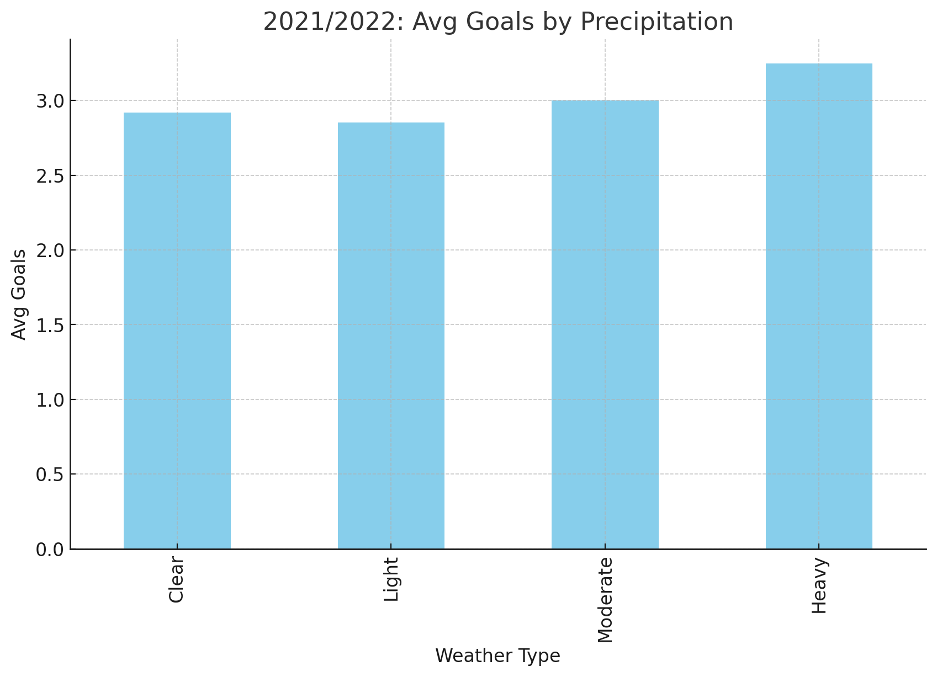
2021/2022: Weather Impact
In the 2020/2021 season there seems to be no significant correlation between weather and precipitation levels.
Clear weather and all precipitation levels have a similar number of avg goals scored

Slide 12
Conclusion?
Weather does not have a significant correlation with the average number of goals scored. In the 4 seasons we compared there was no solid conclusion we could get to, the only difference we saw was in the 2000/2001 season where light percipitation had a significantly lower avg num of goals but this was inconsistent in the other 3 seasons.

Slide 13
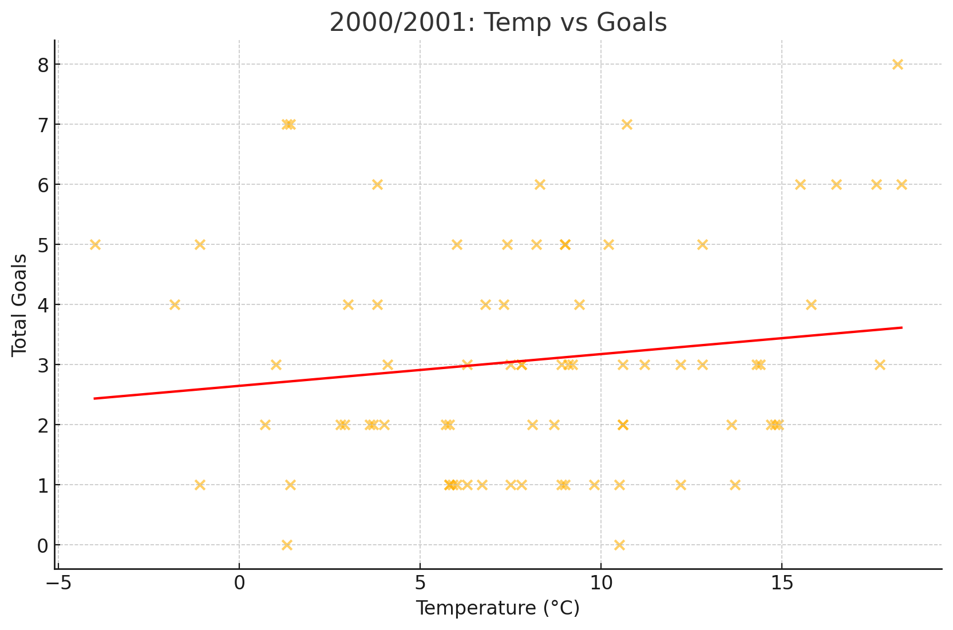
2000/2001: Temperature Effects
Corr r=0.14

Slide 14
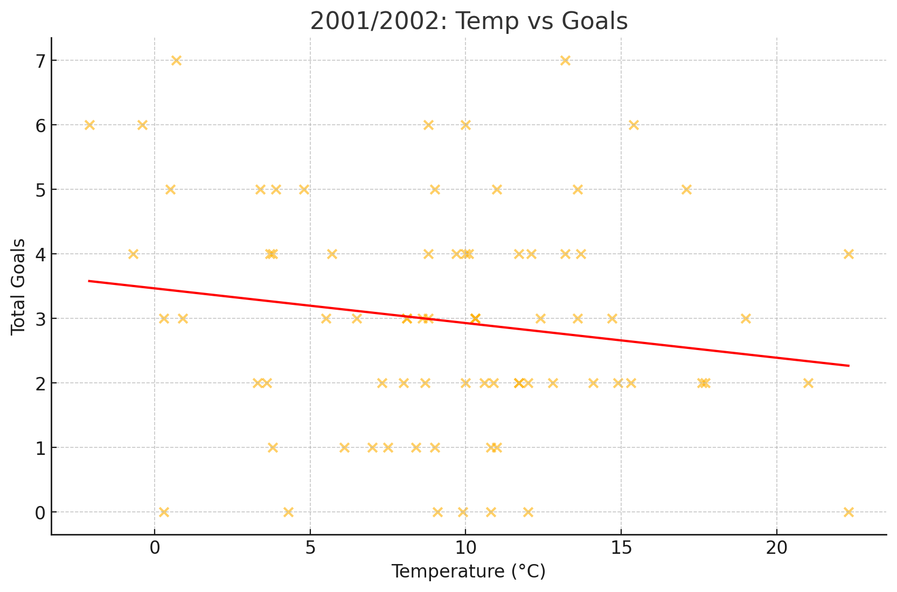
2001/2002: Temperature Effects
Corr r=-0.16

Slide 15
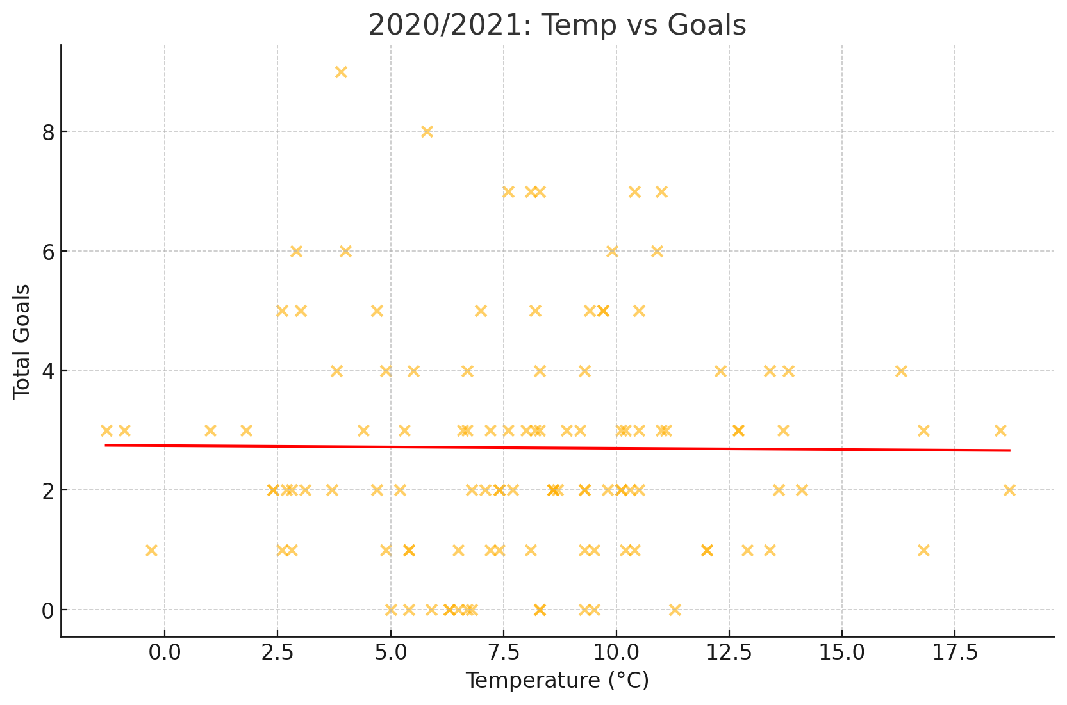
2020/2021: Temperature Effects
Corr r=-0.01

Slide 16
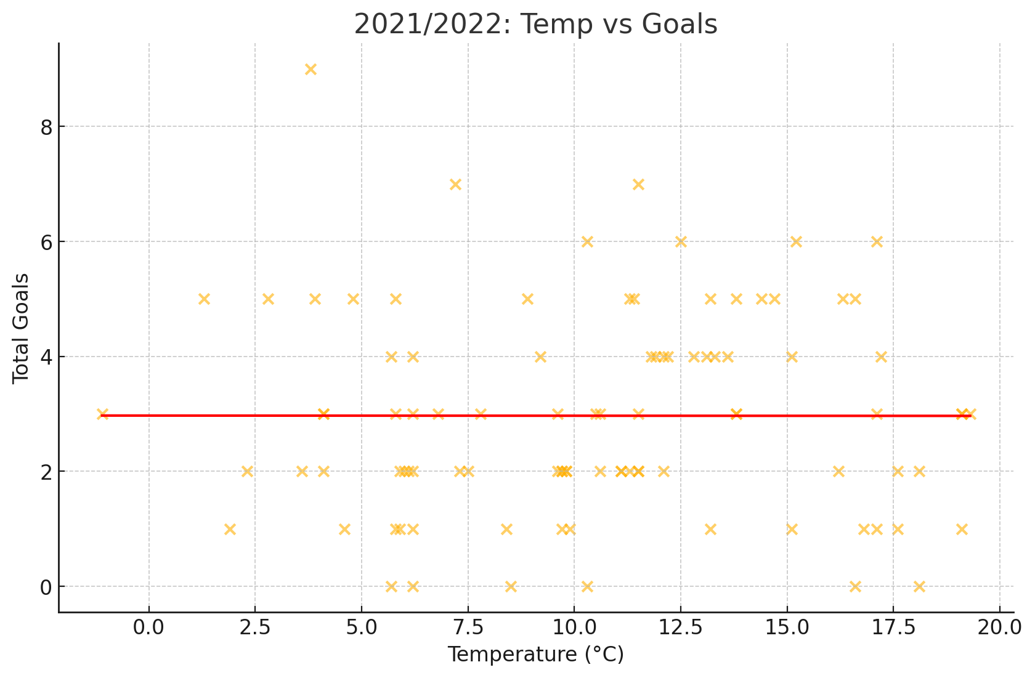
2021/2022: Temperature Effects
Corr r=-0.00

Slide 17
DID TEMPERATURE HAVE AN EFFECT ON THE AVG NUMBER OF GOALS SCORED?
In all four seasons the Correlation Coeffecient was too low and even was 0 in the 2021/2022 season, showing us that there is no correlation between temperature and the amount of goals scored.

Slide 18
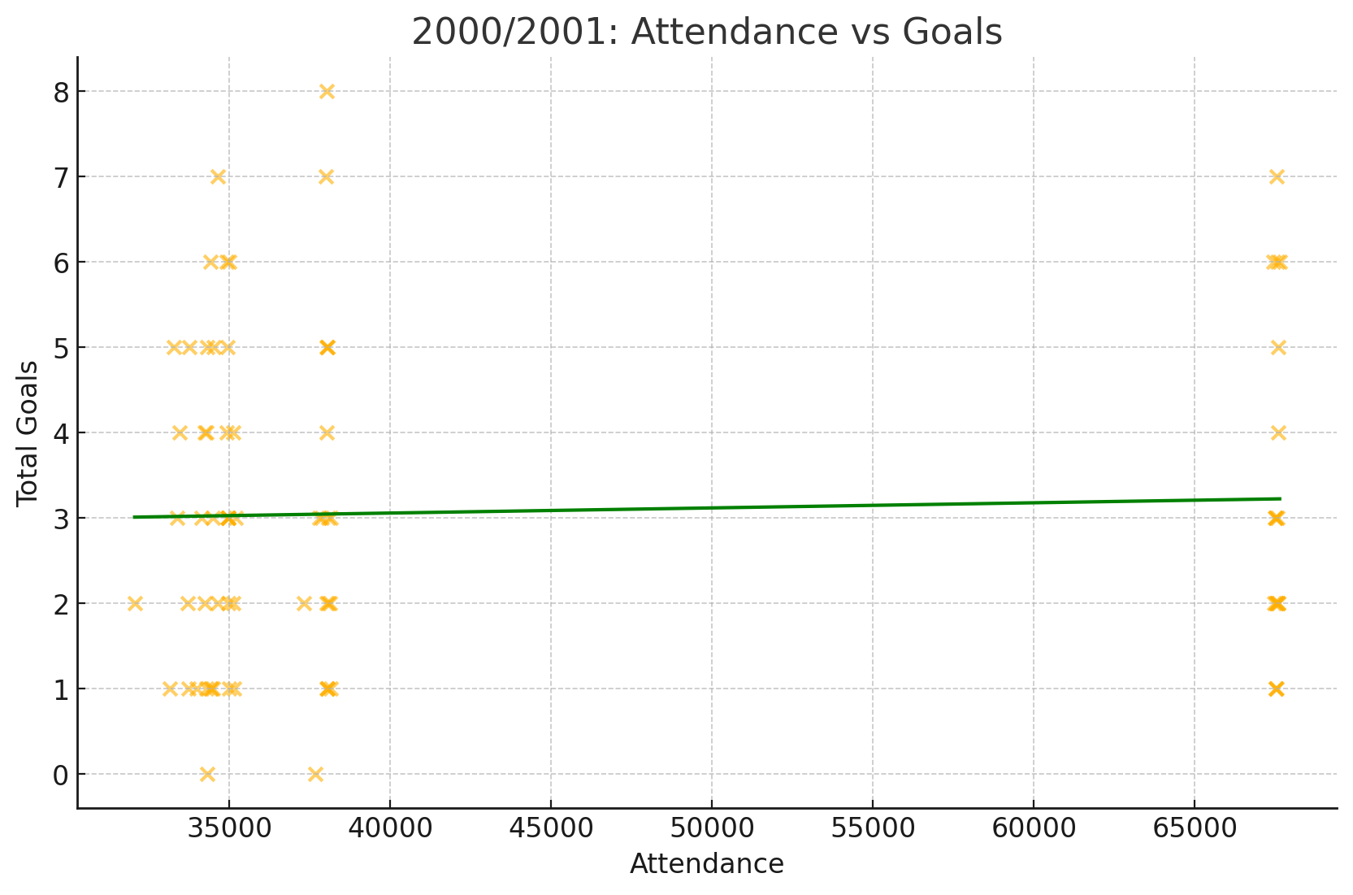
2000/2001: Attendance Impact
Corr r=0.04

Slide 19
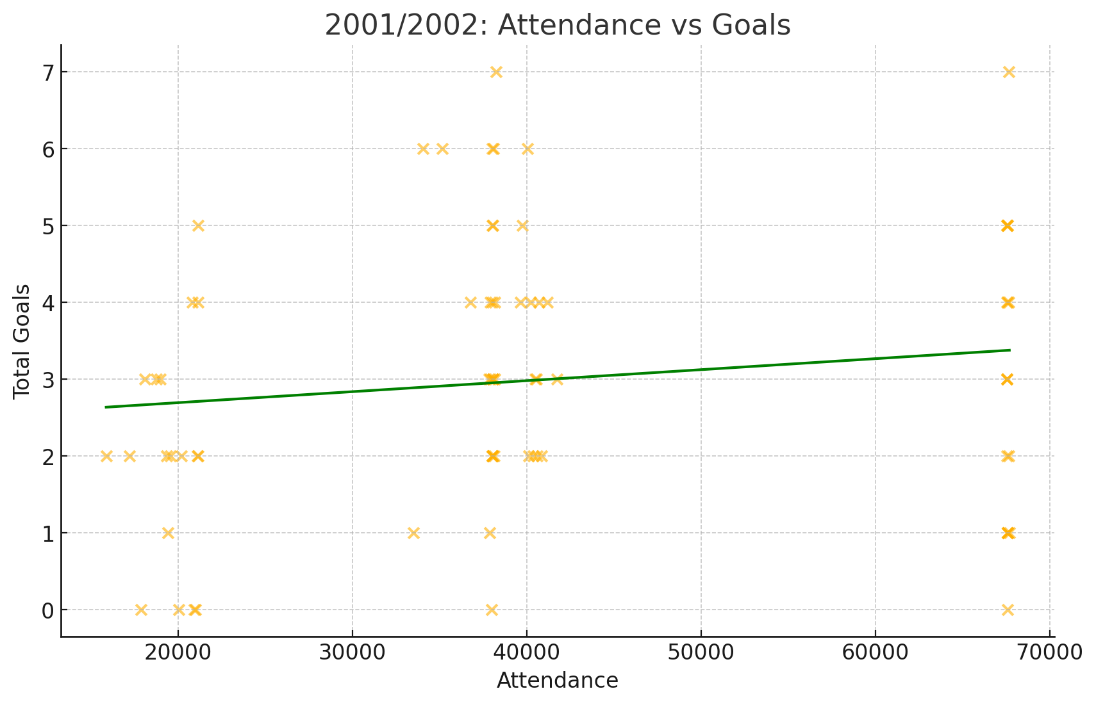
2001/2002: Attendance Impact
Corr r=0.14

Slide 20
Attendance vs goals scored
The correlation coefficient was also too low to be of any significance, showing us that attendance has a very minimal affect on the amount of goals scored.

Slide 21
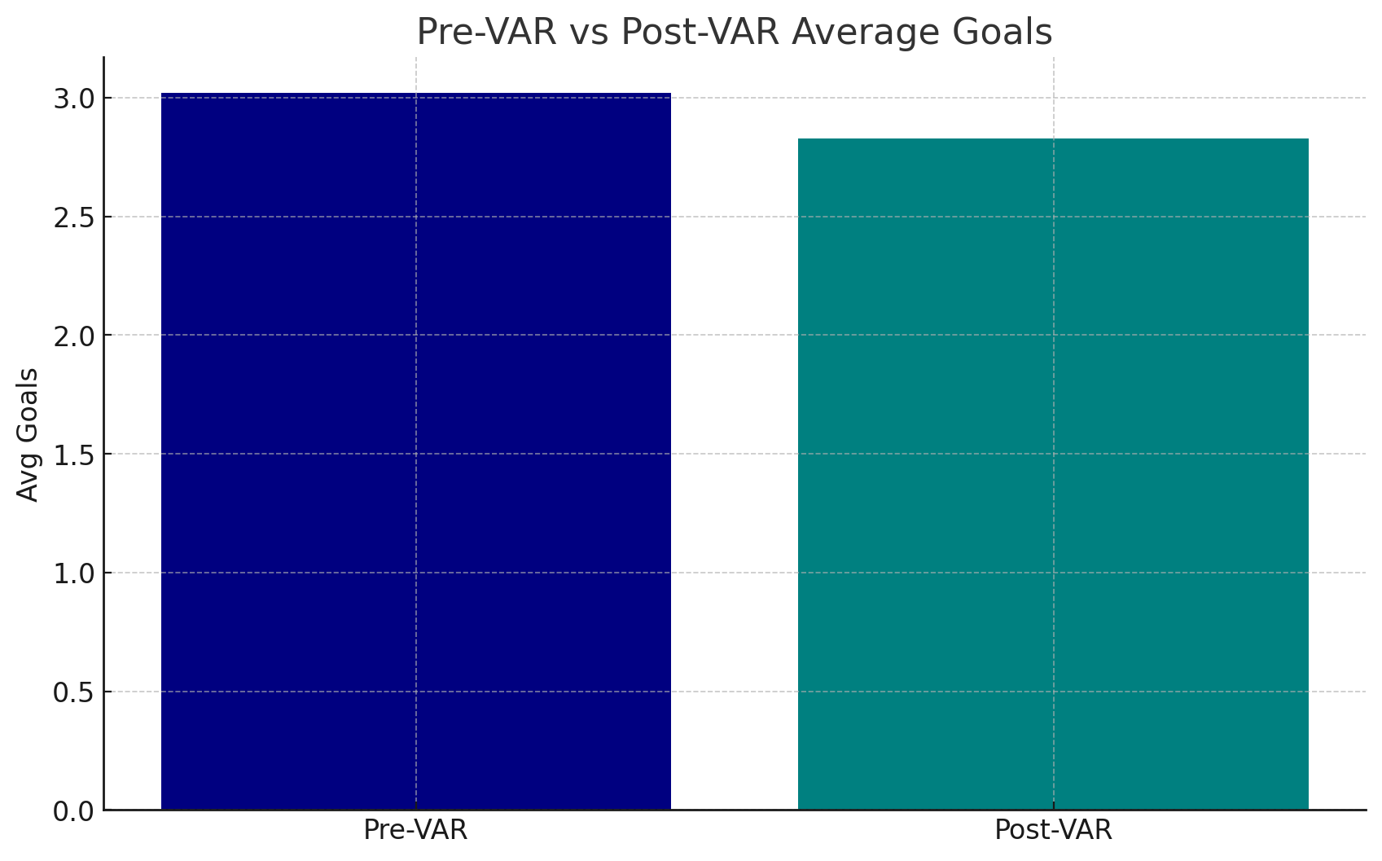
VAR Era Comparison
Pre-VAR avg = 3.02, Post-VAR avg = 2.83, t=-0.97, p=0.332. No significant change between
Pre-VAR and Post-VAR seasons.

Slide 22
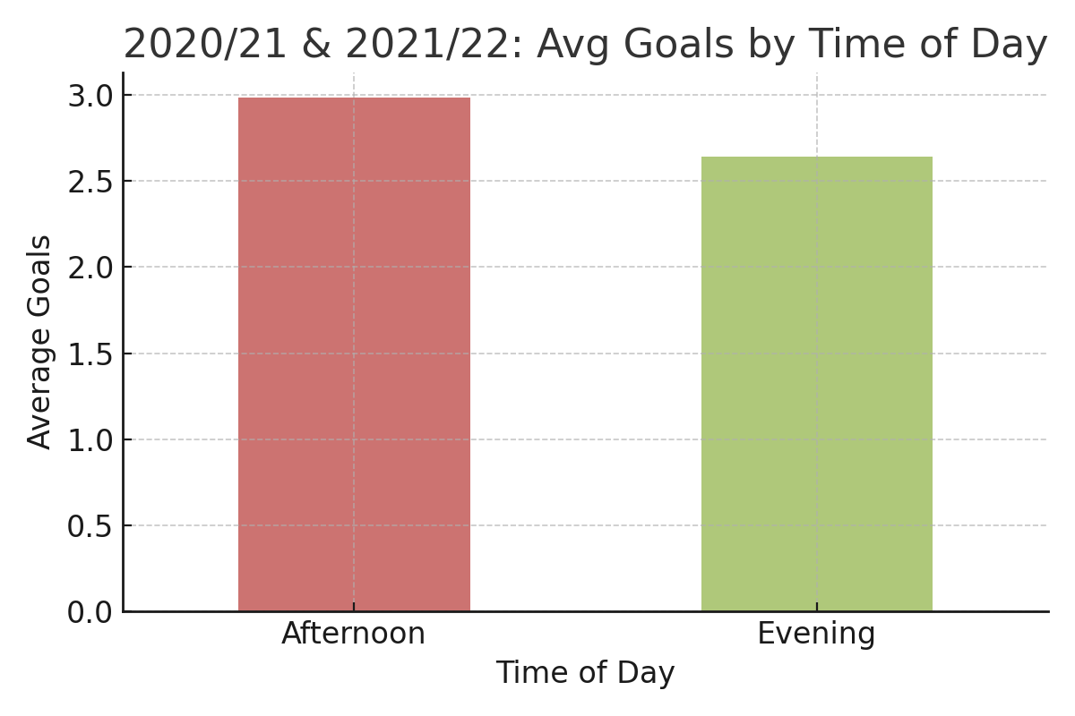
Time-of-Day Goals Comparison
Afternoon matches (n=114) averaged 2.98 goals per match. Evening matches (n=95) averaged 2.64 goals per match.
Very similar avg goals indicating time of day has no significant effect on goals scored

Slide 23
Hypothesis Test: Heavy Rain vs Clear
H0: μ_heavy = μ_clear
H1: μ_heavy ≠ μ_clear
Heavy (n=67) mean=3.10
Clear (n=87) mean=2.92
t=0.54, p=0.589 → Fail to reject H0
Means that there is no significant difference in goals scored when theres heavy rain and when the weather is clear

Slide 24
Conclusions & Next Steps
Seasonal scoring distributions are stable (avg ~3.0 goals).
Weather has minimal effect on goals scored
Temperature shows negligible correlation (r<0.3).
Attendance impact is weak (r<0.3) across seasons.
VAR introduction had no significant effect on avg goals.

